Slide 1
Out the box thinking
… or simply
What every person deserves
…Support when needed
And
Dignity

Slide 3
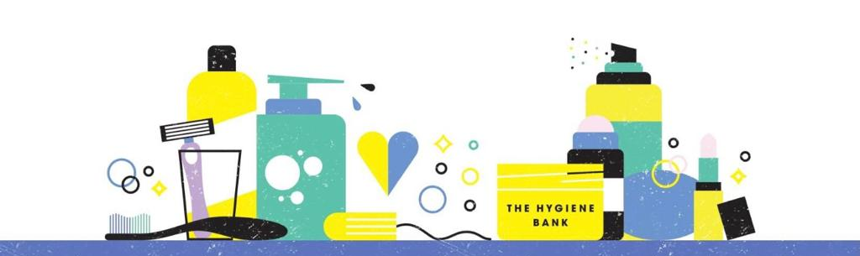
https://thehygienebank.com/

Slide 4
GET PRODUCTS - BECOME A COMMUNITY PARTNER
https://thehygienebank.com/get-products/
https://app.smartsheet.com/b/form/1c2641ff59414928b2eb43bf0889cd21

Slide 5
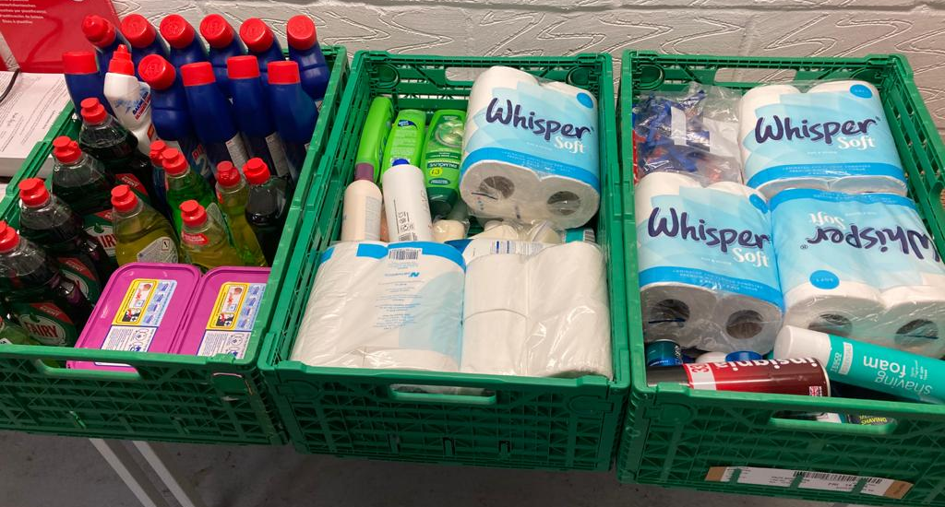
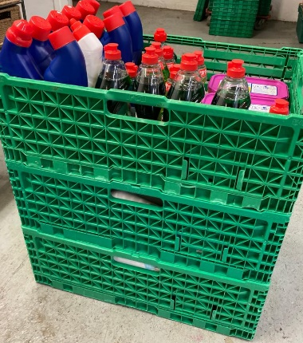
Whats in your distribution Centre packs:
Your distribution packs are your emergency supplies, where a practitioner identifies a need for one or two items and an immediate need. Professionals can give them out there and then to the client. Some items may come in multi packs (toilet rolls, tampons, soap, laundry detergent etc), you will be required to break down packs to distribute. Remember: your centre stock is for emergencies; you can refer and request packs of multiple items to be delivered to your centre within a couple of days. *We may adapt/ add to these packs as we learn what’s needed and all these items are obviously subject to stock availability- If we have them, then we will make sure you have them!
12 x
Bleach
Shower gel
Shampoo
Bars of Soap
Deodorant
Adult Toothpaste
Adult Toothbrush
Child Toothpaste
Child Toothbrush
(safety)Razor if available
Multi-Surface cleaner
Washing up liquid
24 x
Laundry detergent (capsules/ pods etc)
6 x
Toilet rolls (4)
Sanitary pads (packs)
Handwash
Packs of mask
4 x
Tampons (boxes)
We will supply you with a distribution emergency pack (2-3 crates of items which you will need space to store. They will stack if preferred)
As professionals/ practitioners you can either hand out 1 or 2 individual items in an emergency from your stock to meet an immediate need or you can send a referral into us via email using the referral form

Slide 6
You can send a referral through to THB at any time via email, the email box is monitored by our volunteers regularly. Your referral will be processed and despatched either directly back to you or to the foodbank for next working day delivery (whichever has been agreed).
What products we can offer; what’s in our standard packs (stock permitting).
Note: Family packs will be created by the appropriate combination of these packs and you can request specific combinations, omitting standard items *only if specifically requested

Slide 7
