Slide 1


Slide 2
Can we build a city where no child spends their entire childhood in poverty and all children grow up in conditions which enable them to thrive?

Slide 3


Slide 4
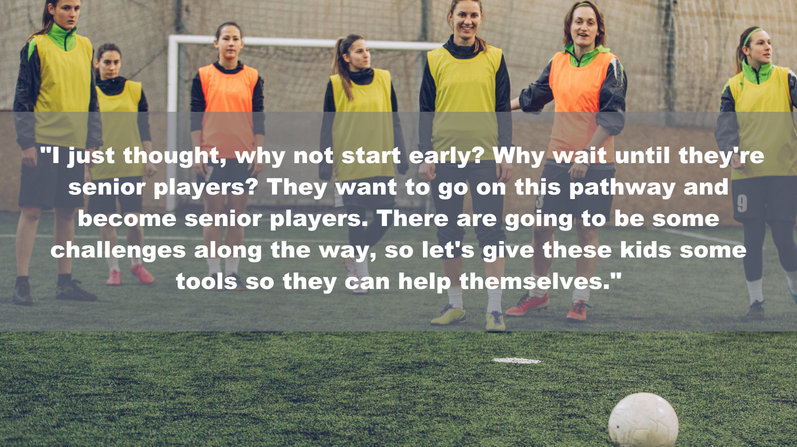

Slide 5

A FUTURE-PROOF BLUEPRINT

Slide 6





IMPACT FACTORS

Slide 7
PERSONAL BELIEF
An innate and strongly held hopeful conviction that a fulfilling life, free from poverty is accessible.

Slide 8
ENGAGING EDUCATION
An education experience which is consistent, inspiring, equipping and prepares students for entry into adulthood.

Slide 9
MEANINGFUL MONEY
A variety of employment opportunities which are physically accessible, attainable and which pay meaningful sums enabling freedom from poverty

Slide 10
HEALTH, HOME & HOOD
A domestic and neighbourhood experience free from danger, fear and violence.
Where infrastructure (digital & physical) enhances ability to learn, earn and enjoy good health.

Slide 11
RESILIENCY RESPONDERS
Help-agencies able to provide holistic assistance, transformational support or mitigating action in moments of difficulty, trauma or crisis.

Slide 12
CHANGE THEORY
Identifying factors of detrimental impact also identifies the corresponding beneficial flip side.
If we build systems, programmes and projects which create the conditions of the beneficial flip side, we will create a city-wide environment which is of positive and pre-emptive benefit to children; ensuring minimum time spent in poverty and increasing the chance of an adulthood not typified by financial hardship.

Slide 13
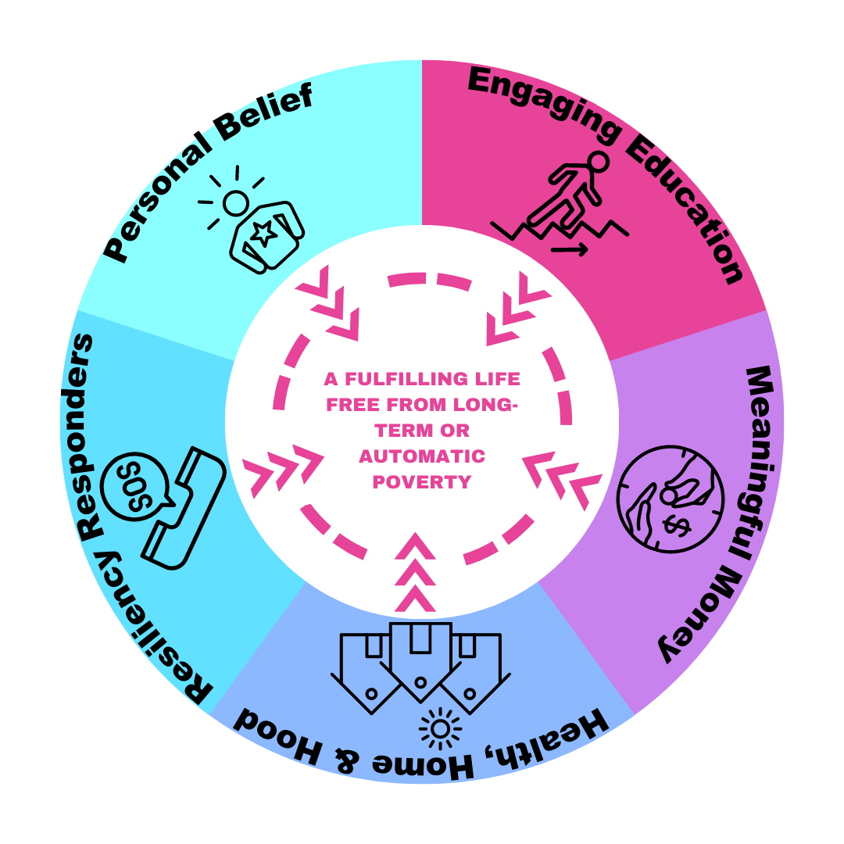

Slide 14
CHANGE SYSTEM
If the described factors of beneficial impact are
the end-goal…
What needs creating / building / implementing / changing / stopping in order to create these environments in reality?
Personal
Belief
Engaging Education
Meaningful Money
Home ’n’
Hood
Resiliency Responders

