Slide 1

Period Poverty Resource Pack Milton Keynes

Slide 2
Contents
Access to free period products in schools and colleges in England
Wrap around support to complement the DfE offer, including where to direct young people out of school hours and holidays
Education and resources for schools and settings working with all young people which includes lesson planning and talking about puberty
School holiday access
More coming soon including:
Training, advice and guidance on making and accessing eco products
A support poster created by young people

Slide 3
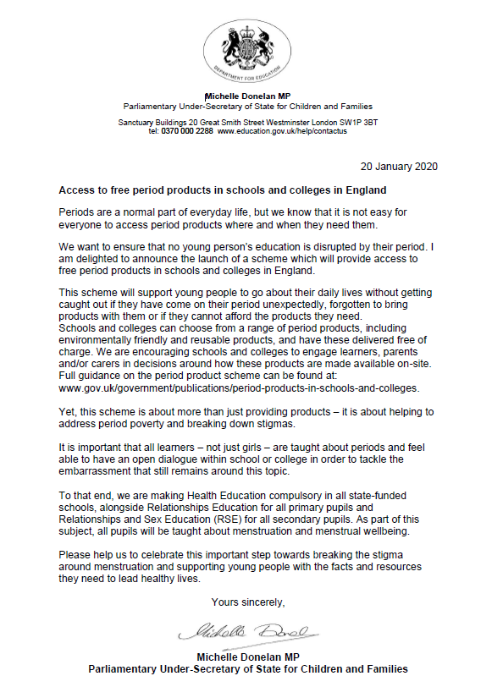
Access to free period products in schools and colleges in England
Full guidance on the period poverty scheme can be found at: www.gov.uk/government/publications/period-products-in-schools-and-colleges
18 Jan 2020

Slide 4

Where to access free sanitary products
Are you using free products available?
The Red Box Project - click into the Schools section
If you are a member of staff working in a school or someone closely connected to a school, The Red Box Project would love to offer their free support. Please email: schools.rbp@gmail.com and a member of The Red Box Project team will get back to you straight away.
MK Food Bank
Always
Dear Teacher - if you teach at a UK state secondary school with at least 1% of girls eligible for free school meals, you will be entitled to receive free ALWAYS pads to help keep your girls in school. For more information or to register your school, please follow this link.
Always - If you’re a secondary school, make sure you register for your free class packs containing Always free samples for your students, demonstration kits and additional printed materials on puberty education. Order your free pack now.
Out of hours - In school holidays young people can access Youth Faculty and Children and Family Centres for venues.

Slide 5


Slide 6
Education and resources for schools and settings working with all young people
betty for schools provides free PSHE accredited resources that teachers can use to educate their pupils aged 8-12 about periods. In collaboration with young people and education experts betty for schools has developed innovative and experiential lessons which encourage open and honest conversations about menstruation and the way it affects girls.
With a mix of quizzes, films and animations, the fun and engaging online activities empower teachers to kick-start the conversation in their classroom. All resources are curriculum linked and fully supported with teacher delivery notes and student and parent booklets. Keep your class informed, engaged and at ease with talking about periods!
https://www.tes.com/period-education-betty-for-schools
https://bettyforschools.co.uk/resources
https://bettyforschools.co.uk/
https://period-powerful-hub.totm.com/right-conversations-about-periods-in-schools/

Slide 7
Education and resources for schools and settings working with all young people continued
Always & Tampax
Free puberty kits for schools ‘about you’ puberty education programme
PHE Rise Above
Rise Above - puberty hit list and more

Slide 8
COMING SOON
Advice and guidance on accessing above Youth@milton-keynes.gov.uk
Training, advice and guidance on Making and accessing eco products
An information leaflet created by young people using evidence and existing learning giving advice on where to put products in your school and setting and recommended approaches

