Slide 1
Understanding local mental wellbeing
James Dove
Public Health Principal

Slide 2
Wellbeing Surveys – Work to date
The Oxwell Survey – Pilot (June 21)
30,000 responses (2,000 of these from MK)
Focus on social risk, lifestyle and education
Shared Top 10 issues via HYPN
Specific issues & themes shared with schools
Learning/reflection on process

Slide 3
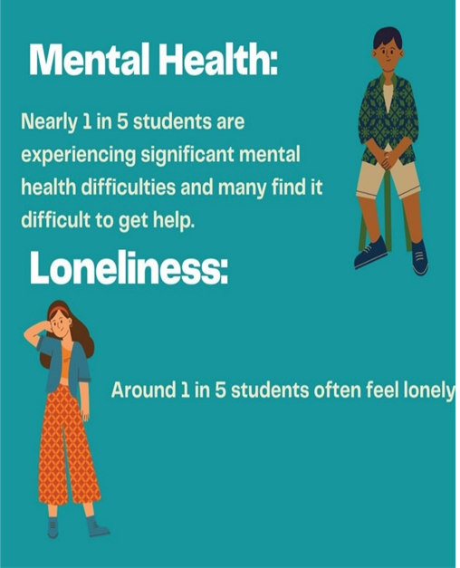
Headline Findings

Slide 4
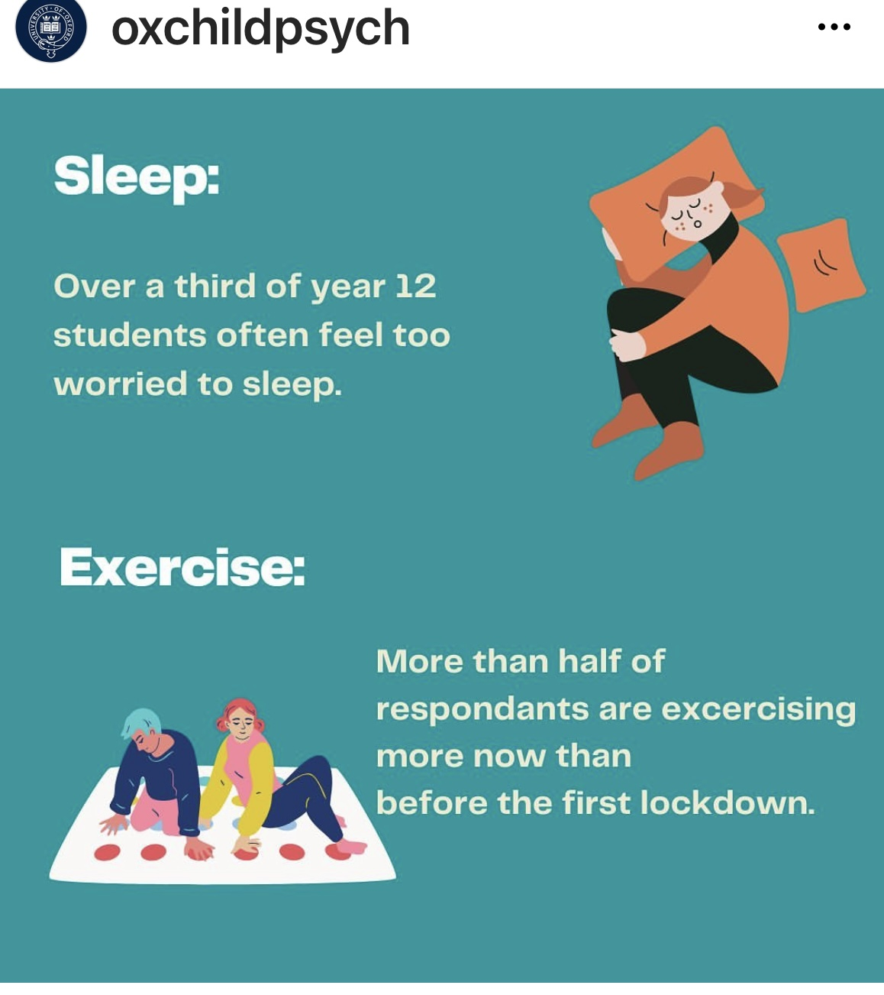

Slide 5
Wellbeing Surveys – Future plans
Wider Oxwell Survey - Early 2023
Survey for Special Schools
Wider sharing of the evidence base
A longitudinal approach
Led by 0-19 service (CNWL)

Slide 6
Thank you

