Slide 1
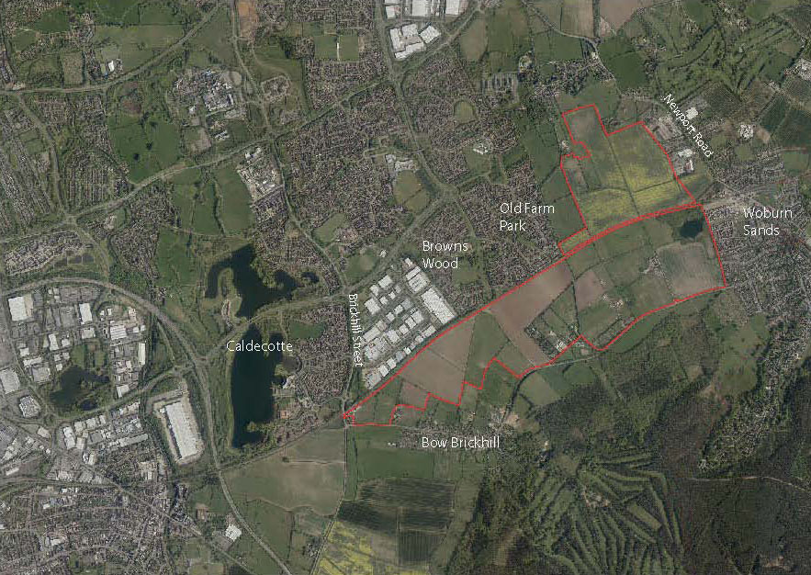

SEMK
Strategic Urban Extension -
Q & A
Sabina Kupczyk
Principal Planning Officer
Andrew Turner
Planning and Transport Policy Manager
Matthew Clarke
Principal Urban Designer

Slide 2
Agenda
SEMK Consultation Q&A
Location: Virtual Meeting
Date: 04th March 2021, 18:00-19:00
Welcome
Brief Presentation
Q&A
Next steps

Slide 3
About SEMK
Location Plan
A Strategic Urban Extension on the South East Edge of Milton Keynes 200ha, 3000 homes
Two primary schools, one secondary, as well as necessary nursery and early years provision.
Local centres and other supporting infrastructure

Slide 4
Unitary council
delivering 250+ services
£730m budget
Robust financial position despite rising demand for services

Slide 5
Unitary council
delivering 250+ services
£730m budget
Robust financial position despite rising demand for services

Slide 6
Site
Analysis

Slide 7
Key Policy from Plan:MK
that influences the Concept Layout for the SEMK
Design, land use, transport routes and mobility measures that integrate the Strategic Urban Extension with the existing built up area and enable future expansion beyond the Strategic Urban Extension where appropriate. (SD9)
Ensure development is well connected and integrated with adjacent grid squares, public transport services and the strategic and local highway grid network ( SD1, SD11)
SEMK to be structured on the principles that have shaped the original city, especially the grid road system, redways, linear parks and strategic, integrated flood management (SD1)
Opportunities to extend grid road system design and redways into SEMK required as are safeguarding for land corridors for future highway links (CT8, INF1)

Slide 8
Provision of grade separated crossings of railway (SD11, INF1)
Incorporate buffer areas, structural landscaping and strategic green infrastructure within the site to prevent coalescence with Woburn Sands and Bow Brickhill, respect and reinforce the distinct character of Wavendon, Woburn Sands and Bow Brickhill (SD11)
Existing natural assets to be identified and protected and to have multiple benefits (eg biodiversity plus locations for walking and cycling) (SD1,NE4)
The layout and design of development enables permeable, coherent, easy, safe and pleasant access for pedestrians and cyclists within and connected to the wider area in order to promote/encourage recreation, walking and cycling within the development area and wider area (SD1, CT1, CT3, EH7, D1)
The development proposals as a whole respond appropriately to the site and surrounding context (D1)

Slide 10
The Development Framework Plans

Slide 17
Questions raised by participants prior the event
When the final movement network will be chosen?
What noise and visual mitigations will be proposed to the areas where grade separation will be provided where route crosses Holst Crescent?
Why H10 extending of the H10 grid road to the Newport Road been included as a 'grid road corridor reserve' rather than a definite part of the plan? Why a confirmed extension to the H10 not included in at least one of the scenarios?

Slide 18
Q&A Discussion

Slide 19
Next steps
2nd Q&A session is planned for 11 March 2021 1.00-2.00pm – registration ends 09/03/2021
All comments on the SPD must be received before 5.00pm on April 19 2021.
Consultation webpage: https://www.milton-keynes.gov.uk/planning-and-building/planning-policy/south-east-milton-keynes-strategic-urban-extension
Contact details: SEMK@milton-keynes.gov.uk or by telephone on 01908 691691.

