Slide 1

SEMK Local Stakeholder Group
16:00-17:00 , Monday 16th November 2020 Virtual meeting via Microsoft Teams
Agenda | Time
Item 1. Housekeeping and Introductions | 2 min
Item 2. Approval of amended Terms of reference and Minutes from 22/06/2020 (previously circulated) | 1 min
Item 3. South East MK Development Framework -timeline of recent events | 2 min
Item 4. Overview of options presented at Planning CAG workshop (Matthew Clarke) | 5 min
Item 5. Question and Answer Session | 40 min
Item 6 Next Steps | 5 min
Item 7. A.O.B | 5 min

Slide 2
South East MK Development Framework -timeline of events
Summer 2020
SE MK Local Stakeholder Group meeting June 2020 (comments received from LSG group memebrs)
Autumn 2020
Further meetings with developers
Planning CAG workshop November 2020 on Public Transport and Social Infrastructure
Upcoming events
Draft SE SUE SPD to be presented to Planning CAG on the 9th December 2020
Discussions with the developer group continue on concept and layout related matters (to the extent possible without the Transport Study findings) and on the principle and content of a Framework Agreement.
Planning CAG workshop August 2020 and invitation for comments from wider public on matters raised
Meeting with LSG, MK South Group
Draft SPD to be taken to Delegated Decision meeting in January 2020
Consultation on the draft SPD in February 2021.
It is anticipated that the SPD will be adopted in Summer 2021.

Slide 3
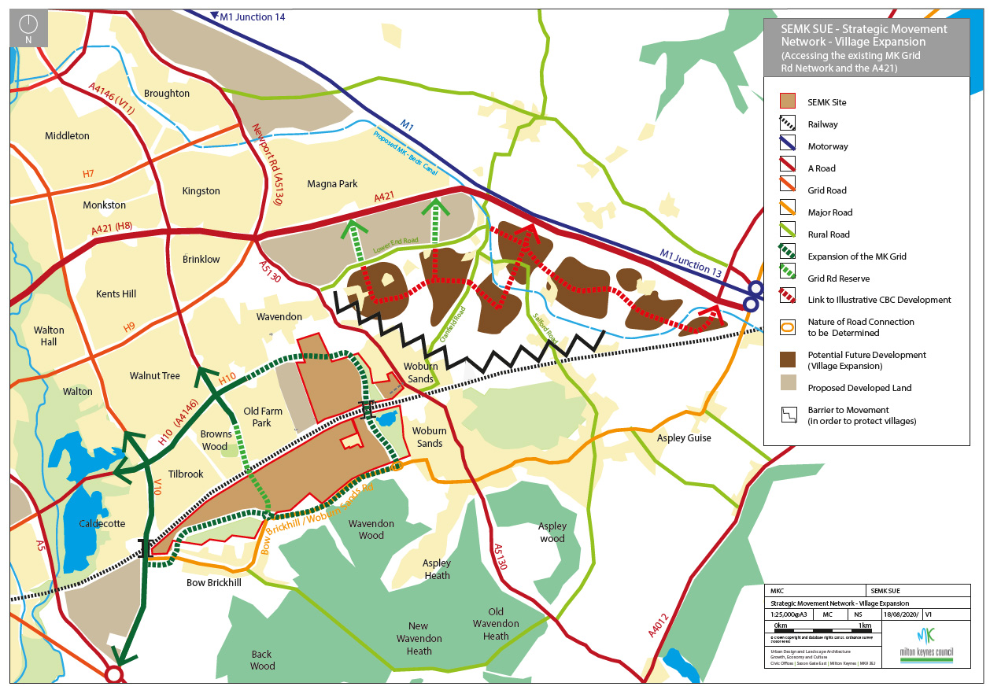
‘Protect the Villages’
Response 1 preferred
following Planning CAG
Workshop in August
Unitary council
delivering 250+ services
£730m budget
Robust financial position despite rising demand for services

Slide 4
Open Space
Network
Unitary council
delivering 250+ services
Buffers
Green Infrastructure
Pedestrian Cycle Network
£730m budget
Robust financial position despite rising demand for services

Slide 5
Public Transport / Movement Network
Response 1 - V10, Woodleys grade separated all movement crossings
Scenario
‘The transport study and modelling indicates that the impact in terms of traffic and public transport do not justify the extension of the V11 into the site. As a result the Grid Road corridor will be reserved

Slide 6
Public Transport / Movement Network
Response 2 - V11, Woodleys grade separated all movement crossings
Scenario
‘The bridge at V10 proves to be unviable as a result of existing constraints, V10 is stopped up , or has long delays at the existing level crossing as a result of the increased volume and speed of the trains. Traffic is rerouted via the Bow Brickhill by-pass and an extended V11.

Slide 7
Public Transport / Movement Network
Response 3 – V10, V11, Woodleys grade separated all movement crossings
Scenario
‘The transport study and modelling indicates that the impact in terms of traffic and public transport requires three points of vehicular connections between the north and south of the site. V10, V11 and the Woodleys Crossing’
Notes:
Add heading to each of the 3 responses: Composite Response 1: Strategic Movement, pedestrian/cycle and open space network and buffers

Slide 8
Composite Response 1:
Strategic Movement, pedestrian/cycle and open space network and buffers

