Slide 1
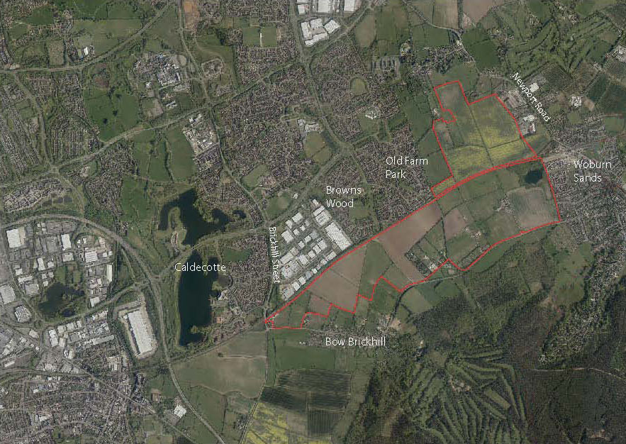

SEMK
Strategic Urban Extension -
Q & A
Sabina Kupczyk
Principal Planning Officer
Andrew Turner
Planning and Transport Policy Manager
Matthew Clarke
Principal Urban Designer
James Povey
Strategic Lead Transport Policy and Planning

Slide 2
Agenda
SEMK Consultation Q&A
Location: Virtual Meeting
Date: 11th March 2021, 13:00-14:00
Welcome
Brief Presentation
Q&A
Next steps

Slide 3
About SEMK
Location Plan
A Strategic Urban Extension on the South East Edge of Milton Keynes 200ha, 3000 homes
Two primary schools, one secondary, as well as necessary nursery and early years provision.
Local centres and other supporting infrastructure

Slide 4
Unitary council
delivering 250+ services
£730m budget
Robust financial position despite rising demand for services

Slide 5
Unitary council
delivering 250+ services
£730m budget
Robust financial position despite rising demand for services

Slide 6
Key Policy from Plan:MK
that influences the Concept Layout for the SEMK
Design, land use, transport routes and mobility measures that integrate the Strategic Urban Extension with the existing built up area and enable future expansion beyond the Strategic Urban Extension where appropriate. (SD9)
Ensure development is well connected and integrated with adjacent grid squares, public transport services and the strategic and local highway grid network ( SD1, SD11)
SEMK to be structured on the principles that have shaped the original city, especially the grid road system, redways, linear parks and strategic, integrated flood management (SD1)
Opportunities to extend grid road system design and redways into SEMK required as are safeguarding for land corridors for future highway links (CT8, INF1)

Slide 7
Provision of grade separated crossings of railway (SD11, INF1)
Incorporate buffer areas, structural landscaping and strategic green infrastructure within the site to prevent coalescence with Woburn Sands and Bow Brickhill, respect and reinforce the distinct character of Wavendon, Woburn Sands and Bow Brickhill (SD11)
Existing natural assets to be identified and protected and to have multiple benefits (eg biodiversity plus locations for walking and cycling) (SD1,NE4)
The layout and design of development enables permeable, coherent, easy, safe and pleasant access for pedestrians and cyclists within and connected to the wider area in order to promote/encourage recreation, walking and cycling within the development area and wider area (SD1, CT1, CT3, EH7, D1)
The development proposals as a whole respond appropriately to the site and surrounding context (D1)

Slide 8
Site
Analysis

Slide 10
The Development Framework Plans

Slide 17
Movement Network:
How people north of the crossing (along Newport Road) would have access to Woburn Sands, either on foot or by vehicle?
What would be the impact of the closure of Woburn Sands Station and Closure of Woburn sands level crossings? Why consideration of compulsory purchase of land to allow H10 has not been considered?
Why MKC does not insist on V11 extension southwards with grade segregated crossings at Holst Crescent and Morley Crescent?
If V11 is extended how the playing fields at Brown Woods would be accessed by residents from Old Farm park?
What is the concept of moving the Woburn Sands Station, are there any details around this and who will be leading on this?

Slide 18
Traffic modelling:
What impact of the traffic will be on the roads based on the existing modelling undertaken (especially in relation to Newport Road/Walton Road and Lower End) and what mitigations are proposed against any further significant increase?
What consideration was given to potential increase in traffic around H10/V11?

Slide 19
Green and Blue Infrastructure:
Could the proposed green corridor not be more substantial to preserve rural character of the village of Wavendon?
Why buffer in Wavendon is slimmer than Woburn sands than Woburn sands and Bow Brickhill ?
Could Brown’s Wood linear park be wider?
What is the width of the corridor along Marston Vale Line?
Could greenspaces continue into new linear park stretching from the Caldecotte Brook northwards to Wavendon village, along the southern boundary of the village as a wide green buffer, across Newport Road, and linking into the Proposed Wavendon Park (the former Wavendon golf course)?
Does the lake have to become part of the Parks Trusts network? Is there a Health and Safety report detailing the suitability of the lake becoming part of a public area and what recommendations does this have?
How Vauxhall AC could continue their tenure of the lake if the lake becomes part of Parks Trust?

Slide 20
Design Matters:
What will be done to retain views and noise abatement for existing residents of Old Farm Park and Browns Woods ( views of Brickhill) ?
Will possible overflow of Caldecotte Brook (due to additional run off) be considered?
Could green energy options be considered such as source heat pumps, solar panels?
Can it be insisted that hedgehog highways form part of the development?
Where the access to the playing fields located above the lake will be provided? Has the location of pavilions/changing areas been considered or parking?
What consideration has been given to potential impact of noise/air quality on the lake if a bridge is constructed at Woodleys Road?
How does MKC propose to retain established trees and hedges within SEMK site? Will there be any penalties for their destruction?
Could an existing footpath be redirected to allow it to run through open countryside rather than ending in dead end?

Slide 21
Community facilities, infrastructure provision, Gypsy and Travellers provision:
What type of community support will the site provide e.g. activities and facilities for young people ?
How the infrastructure needed for the development (including provision of schools) is to be funded? Will there be a need of pooling of contributions from developments surrounding Wavendon?
How many sites and pitches are to be allocated?
What is a pitch?

Slide 22
Community facilities, infrastructure provision, Gypsy and Travellers provision:
What type of community support will the site provide e.g. activities and facilities for young people ?
How the infrastructure needed for the development (including provision of schools) is to be funded? Will there be a need of pooling of contributions from developments surrounding Wavendon?
How many sites and pitches are to be allocated?
What is a pitch?

Slide 23
East West Rail and Ox-Cam expressway and MK housing need
Why the Council is proceeding with the production of the SPD despite of the unknowns around EWR and Ox-Cam expressway and recent government announcement? Are existing allocations not sufficient to meet the 2016-2030 requirements?
Will Milton Keynes East allocation not satisfy MK needs for 2016-30 given the completions?

Slide 24
Q&A Discussion

Slide 25
Next steps
Recordings of the Q&A sessions will be uploaded to SEMK consultation page in due course.
All comments on the SPD must be received before 5.00pm on April 19 2021.
Consultation webpage: https://www.milton-keynes.gov.uk/planning-and-building/planning-policy/south-east-milton-keynes-strategic-urban-extension
Contact details: SEMK@milton-keynes.gov.uk or by telephone on 01908 691691.

