Slide 1
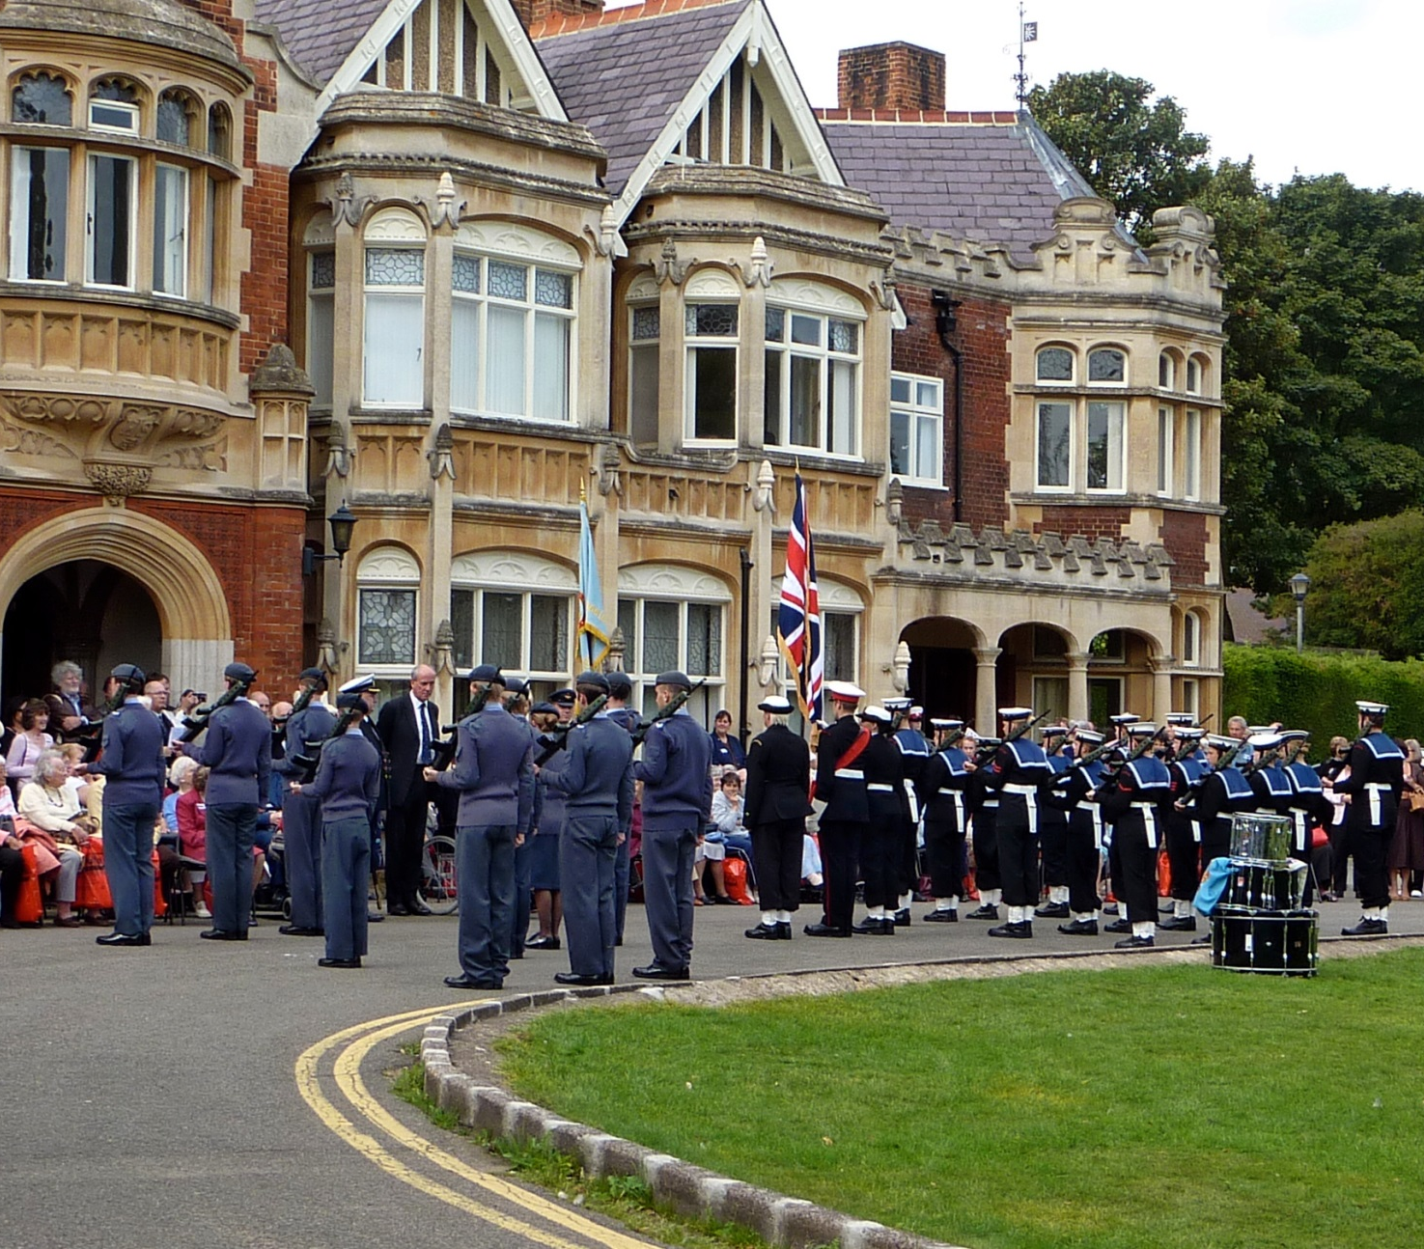
Safety at Public Events

Slide 2
Guidance for event organisers
This guidance document should be consulted by any individual or group who are considering holding a public event in Milton Keynes. The document will assist event organisers in determining whether the Milton Keynes Safety Advisory (MK SAG) should be informed of the event.
The MKSAG is a single point of contact for all relevant authorities in Milton Keynes that provide advice on event safety based upon the most recent best practice available.
Please note not all events will require notification to the MKSAG. If you are under any doubt please fill in the relevant MKSAG notification form and we shall contact you if necessary.
Contents
1. Introduction 2
2. Event Management Plan 3
3. Risk Assessment 4-5
4. SAG notification form 6-7
Issues to consider 8-9
6. Further reading 10
7. SAG membership 11

Slide 3
Introduction
This guide will assist any individual, group, organisation or company who are considering holding or running a public event held in the borough of Milton Keynes. The guide will:
Provide brief advice on the organisational requirements of an event
Help you to decide whether the Milton Keynes Safety Advisory Group (MKSAG) should be notified of your event
Provide advice for the completion of an Event Safety Management Plan
Provide advice for the completion of a basic Risk Assessment
Provide advice for the completion of the MKSAG Notification Form
Signpost you towards detailed event safety guidance relevant to the scale of your event
Inform you of the membership of the MKSAG
This guidance is not designed to provide you with all the information to enable you to conduct a full safety management plan for your event. The MKSAG is designed to advise and monitor events, with individual responsible authorities, such as the Council, Police and Fire Service willing to give more specific advice when approached. It is the responsibility of the event organiser to ensure the event is safe and successful
Quick Start Guide – overview of what you should consider:
Event Safety Management Plan – what your event consists of and what will be done to ensure the event runs safely
Risk Assessment – it will assist in documenting any potential hazards allowing control measures to be identified
Complete MKSAG notification form – if necessary
Any other licenses or permissions as required

Slide 4
Planning your event
The Event Management Plan
Every event will need to have a suitable plan designed to ensure everything runs smoothly. The plan for a large scale 60,000 attendee event, for example, will differ to that of a low key church fete with 100 people expected. When considering the extent of your safety plan you should consider the risk to all participants and attendees.
The MKSAG will consider a sliding scale approach to what is expected from event planners. A larger event would require far more detailed preparations and plans. A lesser risk, smaller event will not require as detailed documents.
The Event Management Plan should consider the following:
Details of the event and activities taking place
Event Safety Plan which details the hierarchical structure of who is responsible for safety and what is the individual’s actual role
Event Risk Assessment
Additional documents could include:
Site Safety Plan
Crowd Management Plan
Traffic and Transport Management Plan
Emergency Plan
Welfare Plan
Medical Plan
Communications Plan with contact details
Security Plan

Slide 5
Risk Assessment
A risk assessment is a key document for identifying potential hazards and how those hazards can be mitigated through control measures.
The risk assessment is essentially a list of hazards, both current and potential, with an control measures beside each risk to reduce that risk to an acceptable level. It will not be possible to reduce every risk to zero, nor will it be possible to identify every possible risk. However you should make every effort to address each foreseeable hazard.
A good starting point would be to list:
Activity/ area of concern
What hazards are associated to this activity/ area
Who is at risk
Level of risk (high, medium, low)
Action taken to reduce risk
Reassessed risk level with measures in place to reduce it
There are many example risk assessments available on the internet. Try visiting the Health and Safety Executive website for further information: http://www.hse.gov.uk
Please note that not every event will require the same level of detail for the risk assessment.

Slide 6
Example Risk Assessment
Area of activity/ concern | List all activities that may involve a risk to a colleague/ member of the public/ equipment/ premises
What hazards are associated to this activity / area | Identify what could go wrong with this activity
Who is at risk | Identify who would be at risk: colleague/ member of the public/ equipment/ premises
Likelihood of risk occurring | Is the risk likely or unlikely to happen
Severity of risk | If the risk happens, how significant will it be; will people be hurt or just inconvenienced
Risk rating | Combination of likelihood and severity (see additional table below)
Action taken to reduce risk | How will you reduce either the likelihood or significance of risk
Reassessed risk level with measures in place to reduce it. | Describe the final risk with actions taken and by whom, to ensure the risk is within tolerable levels.
To identify the risk rating you should combine the score given to severity and likelihood of risk occurring. By multiplying the scores in brackets you can identify the total risk rating. High severity and high likelihood will result in high risk rating. Each risk should be identified separately and scored as such. The rating is recalculated after measures are identified to reduce it.
Severity of risk | High (3) | 3 | 6 | 9
 | Medium (2) | 2 | 4 | 6
 | Low (1) | 1 | 2 | 3
Risk identified |  | Unlikely (1) | Possible (2) | Likely (3)

Slide 7
SAG Notification Form
If you consider it necessary to notify the MKSAG, you should fill in the MKSAG Notification Form send it to the address included on the form. The form should be issued alongside the event safety plan, risk assessment and any other associated documents.
https://www.milton-keynes.gov.uk/environmental-health-and-trading-standards/licensing/event-public-safety
Why notify the MKSAG of your event?
Although there is no requirement to inform the MKSAG of an event, in doing so you will gain free access to advice and contacts that will have vast levels of experience and will be able to ensure the process of organising a safe event is not as onerous as it may first appear and potentially avoid the many pitfalls that threaten the safety of a public event.
MKSAG members will be able to assist you with alcohol/ entertainment licenses, food safety, Health and Safety, road closures etc.
Prompt communication in the early stages of the organising process will ensure best practice is integrated into your plan from the beginning.
When determining whether you need to contact the MKSAG about your event, you should consider the scale and number/ types of risks associated to it. A large community fair with bands, bars, fairground will certainly require communication with the MKSAG. A small community gathering in a church hall would be unlikely to require any input from the SAG.
A street party where a road is blocked, alcohol being served and music played would require a more robust risk assessment and early interaction with the authorities to ensure the appropriate permissions/ licenses and safety considerations are made.
A large music festival would require Event Safety Professionals and detailed documentation of the events, activities, contingency plans, public engagement on effects of the event on the local population etc.
In any circumstance the event organiser must consider the activities and risks involved to determine what action to take.

Slide 8
Please consider the issues below to assist you in the completion of your MKSAG Notification Form.
How to define your event?
When completing the notification form you should consider the questions below in order to provide an accurate description of what the event will entail:
Why are you holding the event?
What is the theme or key message your event is trying to convey?
Who is it aimed at?
Who will be the attendees?
How many people do you want to attend?
What kind of site or venue do you want?
Where will it be? What is the location?
When do you want it to take place?
What activities will happen at your event?
How long will the event last?
Who will be involved in the planning and execution of the event?
How will you fund the event and how much will it cost?
Is it a public event?
When completing the notification form you should consider the questions below in order to provide an accurate description of what the event will entail:
Why are you holding the event?
What is the theme or key message your event is trying to convey?
Who is it aimed at?
Who will be the attendees?
How many people do you want to attend?
What kind of site or venue do you want?
Where will it be? What is the location?
When do you want it to take place?
What activities will happen at your event?
How long will the event last?
Who’s involved in the planning and execution of the event?
How will you fund the event and how much will it cost?

Slide 9
Key issues to consider for a public event
Although it would be impossible to list all the features of an event that must be considered, below is a list of some of the most important. Early contact with the MKSAG will ensure that you are aware of many of the potential pitfalls. This is not a comprehensive list and the responsibility for complying with legislation and other regulatory requirements will be the responsibility of the event coordinator:
Alcohol/ Entertainment Licence
If you are planning to provide alcohol or regulated entertainment (music, films, dancing etc) you will be required to obtain a Licence or permission. This can take up to eight weeks for this to be granted. Smaller scale events involving under 500 people can apply for alcohol and entertainment provision using a Temporary Event Notice, which does not require such an extensive consultation period. The Council Licensing Officers can advise you through the process.
Noise
Live entertainment, use of speakers, loud machinery and tannoys can cause nuisance and be subject to restrictions. Environmental Health Officers will be able to provide advice to prevent or limit difficulties with noise.
Food Safety
If food will be prepared or provided at an event, then you should contact the Council Food Safety Team for advice.
Health and Safety
Although often considered onerous and complicated, health and safety considerations can be very straight forward and you will receive support from Council Environmental Health Officers.
Road Closures
Road Closures are no longer administered or supported by the Thames Valley Police. Application to close a road under a Traffic Management Order can take up to three months. You should contact Council Transport Officers for advice on this process.
Disabled attendees
Have you got suitable provisions in place.

Slide 10
Land Owners Permission It is important to ensure you have the land owners permission to use the land your event will be held on. It is not always obvious who owns the land and you may find yourselves trespassing.
Security
Will the attendees be safe? Are there enough stewards and/ or fully licensed SIA security staff? The Police and Environmental Health Officers will be able to provide advice.
Infrastructure
Do you have adequate water, electricity, toilets, lighting, parking, temporary structures etc. Building Control and Environmental Health officers can assist.
Policing
The role of the police is often misunderstood, with event organiser expecting a free crowd/ traffic/ security management team to be provided. The role of the police is to detect and prevent crime and provide a coordinated response in the event of a major incident. The police have vast levels of experience and are keen to provide advice and assistance in the early stages of planning to ensure your event is secure and safe.
Fire Risk Assessment
It is the responsibility of an event organiser to carry out a Fire Risk Assessment. Bucks Fire and Rescue Service are happy to provide assistance and advice where required.
South Central Ambulance Service and First Aid provision
Depending on the number or attendees, it is likely that your event will require you to provide adequate first aid. South Central Ambulance and appropriate first aid provider will be able to provide you with assistance in determining what is required.
Local residents and Businesses
If the event is likely to affect local residents and businesses it will be worth advising them what is going on. This will build public support and increase tolerance for the activities you are hoping to provide. You may even find willing volunteers to assist.

Slide 11
Further Guidance Documents
Listed below are some additional documents to assist you. For the larger events, we’d expect consideration of and reference to, for example the Green and Purple guides. For a smaller fete with fewer risks, we’d expect this level of consultation.
Five steps to risk assessment
Produced by the Health and Safety Executive ISBN: 9780717661893
The Event Safety Guide: A Guide to Health and Safety and Welfare at Music and Similar Events
Produced by the Health and Safety Executive ISBN: 9780717624539
Guide to Safety at Sports Grounds
Produced by the Department for Culture, Media & Sport ISBN: 978011702074
Managing Crowds Safely
Produced by the Health and Safety Executive ISBN: 9780717618347
The Highway Code
Produced by the Department of Transport (D of T) ISBN: 9780115528149
Regulatory Reform (Fire Safety) Order 2005
Produced by the Department for Communities and Local Government (DCLG) ISBN: 0110729455
www.firesafetyguides.communities.gov.uk
Fire Safety Risk Assessment - Open Air Events and Venues
Produced by the Department for Communities and Local Government.
ISBN: 9781851128235
www.firesafetyguides.communities.gov.uk
Working Together on Firework Displays: A Guide to Safety for Firework Display Organisers and Operators
Produced by the Health and Safety Executive ISBN: 9780717661961
Giving Your Own Firework Display
Produced by the Health and Safety Executive ISBN: 9780717661626

Slide 12
The Milton Keynes Safety Advisory Group (MKSAG)
The MK SAG is made up of a number of agencies that regulate, enforce and advise on safety matters in many areas of the community. They include:
Milton Keynes Council
Environmental Health
Licensing
Health and Safety
Buckinghamshire Fire and Rescue Service
South Central Ambulance Service
St Johns Ambulance
Emergency Planning
Community and Leisure
Building Control
Transport
Waste
Highways
Thames Valley Police
Buckinghamshire Fire and Rescue Service
South Central Ambulance Service
St Johns Ambulance
Highways England
As the MKSAG, this expertise is centralised allowing for one notification document to be circulated to all relevant agencies reducing the burden on event coordinators.
As a non-statutory body, the MKSAG don’t hold specific enforcement powers. The separate agencies can use their authority to take enforcement action if required. It’s not the intention for the MKSAG to prevent events happening. The primary role of the MKSAG is to promote the safety of the general public at events in MK.
www.milton-keynes.gov.uk
@mkcouncil

