Slide 1
MKCC Greenhouse Gas Emissions Reporting 23/24

Slide 2
2023/24 Emissions
Scope | Emissions Type | Emissions (tCO2e) | Percentage of Total Emissions
Scope 1 | Heating | 1,259.71 | 6.10%
 | Authority's Fleet | 216.31 | 1.05%
Scope 2 | Electricity | 1,736.24 | 8.41%
Scope 3 | Staff Business Travel | 350.73 | 1.70%
 | Working From Home | 668.43 | 3.24%
 | T & D Losses | 150.21 | 0.73%
 | Water | 5.24 | 0.03%
Total Emissions |  | 4,386.86 | 100%
Points to note:
Working From Home emissions data was captured and reported for the first time this year
Schools’ emissions now reported as Scope 3

Slide 3
History of emissions reporting
Scope | Emissions | Emissions | Emissions
 | (tCO₂e) | (tCO₂e) | (tCO₂e)
 | 2021/22 | 2022/23 | 2023/24
Scope 1 | 771.33 | 1,480.67 | 1,476.02
Scope 2 | 3,476.98 | 3,151.90 | 1,736.24
Scope 3 | 640.19 | 1,299.22 | 1,174.61
Total | 4,888.50 | 5,931.79 | 4,386.86
Points to note:
Significant reduction in Scope 2 emissions (Electricity):
Building use - 978.83 tCO2e
Streetlighting – 1,412.45 tCO2e

Slide 4
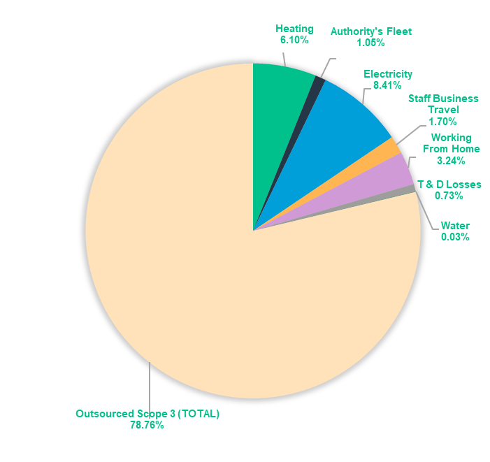
History of emissions reporting – including Scope 3 emissions
Scope | Emissions Type | 2018/19 | 2020/21 | 2021/22 | 2022/23 | 2023/24
Scope 1 | Heating | 7,949 | 6,423 | 6,962 | 8,178 | 1,260
 | Authority's Fleet | 515 | 200 | 51 | 30 | 216
Scope 2 | Electricity | 11,433 | 6,927 | 5,950 | 4,128 | 1,736
Scope 3 | Staff Business Travel | 501 | 268 | 330 | 357 | 351
 | Working From Home | N/A | N/A | N/A | N/A | 668
 | T & D Losses | 975 | 596 | 527 | 378 | 150
 | Water | 9 | 6 | 2 | 3 | 5
 | Outsourced Scope 3 (TOTAL) | 2,726 | 2,246 | 2,579 | 2,532 | 16,267
Total Emissions |  | 24,108 | 16,666 | 16,400 | 15,604 | 20,654
Total Reduction |  |  | 7,441 | 267 | 795 | -5,050
Points to note:
Significant reductions in carbon emissions can be noted from heating and electricity use, both for buildings and streetlighting.
Enhanced data collection from the Council's contracted services has improved reporting accuracy but resulted in a significant increase in Outsourced Scope 3 emissions, leading to the negative total reduction figure. Schools now reported as Scope 3.
Outsourced Scope 3 reported in 23/24: Leisure, Ringway, Thalia, Biffa, SUEZ, Environment Services Depot, New Fleet Depot, Estates & MKDP, Schools
Working From Home emissions data was captured and reported for the first time this year, further contributing to the negative total reduction figure.
2023/24 emissions

