Slide 1

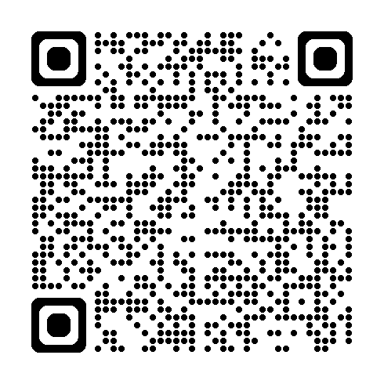


Roll and Stroll at work: Bringing the campaign to life.
Simple, practical ideas to support staff engagement with the campaign and embed walking, wheeling and cycling into everyday working life; now and for the long term
What is the Roll and Stroll campaign?
A new fun, free and friendly active challenge campaign across Milton Keynes running from 1st May - 31st May. It rewards everyday movement that works for you; where every walk, wheel or ride counts. Log trips to win fantastic prizes and compete with other workplaces on the leaderboard.
Small everyday changes can support big workforce benefits:
❤️ Improved health & wellbeing
🧠 Reduced stress, burnout & improved productivity
♿ Inclusive participation for all abilities
🌍 More sustainable travel choices
🤝 Stronger social connections & workplace culture
📉 Reduced sickness absence & improved attendance
What employers can do?
Visit Home : Love to Ride to register your workplace
Download the promotions pack & spread the word Love to Ride
Lead by example, visibility matters
Support champions & provide inclusive activities
Remove practical barriers where possible
Commit to long term sustainable change
Created in the collaboration between the Public Health Workplace Health Team and The Active and Sustainable Travel Team.

Slide 2
Roll and Stroll at work: Bringing the campaign to life.
Simple, practical ideas to support staff engagement with the campaign and embed walking, wheeling and cycling into everyday working life; now and for the long term
Build confidence and skills: Feeling confident and supported makes it easier to give something new a go.
🚶‍♀️ Walk, wheel or ride together – offer guided commutes, buddy systems or group activities
⭐ Appoint Champions who encourage, inspire & help others
🚲 Build skills and improve accessibility through engagement with local schemes (page 3)
Make it social, normal and positive: When walking and cycling feel normal and enjoyable, they’re easier to keep up.
🏅 Use the Roll & Stroll platform for friendly team challenges
📸 Share stories and photos internally
👏 Celebrate taking part, not performance
🧑‍💼 Lead by example – managers and senior leaders take part, share experiences & model flexible, realistic approaches
Make it easy in the real world and start small: Small actions that fit into everyday working life are more likely to stick.
✅ Not every journey has to be active to count, mixing modes and adding short walks all add up
🚗 ‘I live too far away’ - Encourage park and walk options
☀️ Promote lunchtime walks & walking meetings where no extra time or facilities are needed
Created in the collaboration between the Public Health Workplace Health Team and The Active and Sustainable Travel Team.

Slide 3
Roll and Stroll at work: Bringing the campaign to life.
Simple, practical ideas to support staff engagement with the campaign and embed walking, wheeling and cycling into everyday working life; now and for the long term
What support is available locally?
Get around MK : Provides information on greener, sustainable ways to travel and be more active:
  Join a cycling group, find a walking buddy
  Use the journey planner to inspire different ways to travel
Home – LEAP : Supports residents in Buckinghamshire and Milton Keynes with regular movement, physical activity and sport
Workplace Health - Your local Public Health Team provides free initiatives, training & tools to support workplace health & wellbeing
Relevant local schemes
Women’s free cycling sessions - held every second Thursday of the month until July 2026, 6.45pm-8pm at Two Mile Ash School, with free guided rides from April 2026.
Cycling Pop-Up event – Including E-Bike Experience (free one‑month e‑bike loan options for MK resident), bike security marking, and basic bike maintenance support by a qualified bike mechanic (date TBC)
Access to bikes - If you don’t own a bike there are various cycle hire options, including adapted bikes, and ways to buy one
Bikeability - Cycling skills and training to help improve cycling skills and boost confidence, regardless of current experience
Get Walking – Find out where to walk, with leisure routes and trails and how to join free volunteer led walking groups
Created in the collaboration between the Public Health Workplace Health Team and The Active and Sustainable Travel Team.

