Slide 1
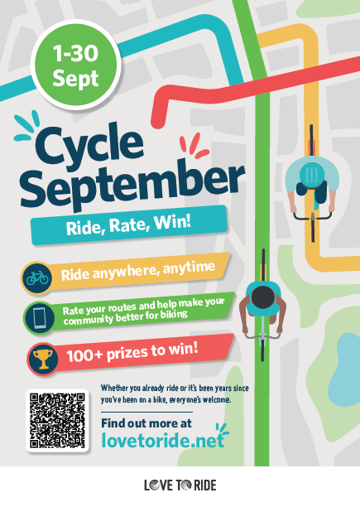

Slide 2

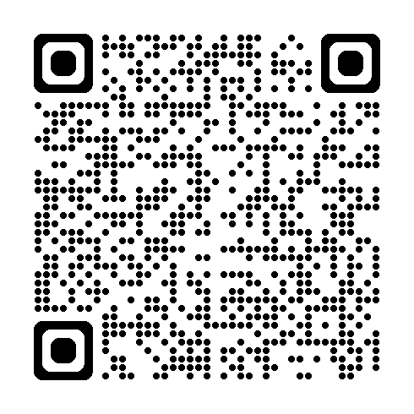


Cycle September at work: Bringing the campaign to life.
Simple, practical ideas to support staff engagement with the campaign and embed cycling into everyday working life; now and for the long term
What is the Cycle to September campaign?
A fun, free and friendly active challenge campaign across Milton Keynes running from 1st September to 30th September. It rewards everyday cycling that works for you; where every ride counts. Log trips to win fantastic prizes and compete with other workplaces on the leaderboard.
Small everyday changes can support big workforce benefits:
❤️ Improved health & wellbeing
🧠 Reduced stress, burnout & improved productivity
♿ Inclusive participation for all abilities
🌍 More sustainable travel choices
🤝 Stronger social connections & workplace culture
📉 Reduced sickness absence & improved attendance
What employers can do?
Visit https://www.lovetoride.net/miltonkeynes to register your workplace
Download the promotions pack & spread the word
Lead by example, visibility matters
Support champions & provide inclusive activities
Remove practical barriers where possible
Commit to long term sustainable change
Created in the collaboration between the Public Health Workplace Health Team and The Active and Sustainable Travel Team.

Slide 3
Cycle September at work: Bringing the campaign to life.
Simple, practical ideas to support staff engagement with the campaign and embed cycling into everyday working life; now and for the long term
Build confidence and skills: Feeling confident and supported makes it easier to give something new a go.
🚲Ride together – offer guided commutes, buddy systems or group
activities
⭐Appoint Champions who encourage, inspire & help others
👥Build skills and improve accessibility through engagement with
local schemes (page 3)
Make it social, normal and positive: When cycling feels normal and enjoyable, they’re easier to keep up.
🏅 Use the Love to Ride platform for friendly team challenges
📸 Share stories and photos internally
👏 Celebrate taking part, not performance
🧑‍💼 Lead by example – managers and senior leaders take part, share experiences & model flexible, realistic approaches
Make it easy in the real world and start small: Small actions that fit into everyday working life are more likely to stick.
✅ If you don’t have a bike, you can hire one via Get Around MK
🚗 ‘I live too far away’ - Encourage park and cycle options
☀️ Promote lunchtime rides or active travel days
💰 Cost savings - cycling can reduce fuel, parking, and transport costs
⚡Consider an e-bike for longer distances or for less confident cyclists
Created in the collaboration between the Public Health Workplace Health Team and The Active and Sustainable Travel Team.

Slide 4
Cycle September at work: Bringing the campaign to life.
Simple, practical ideas to support staff engagement with the campaign and embed cycling into everyday working life; now and for the long term
What support is available locally?
https://getaroundmk.org.uk/ - Provides information on greener, sustainable ways to travel and be more active
https://leapwithus.org.uk/ - Supports residents in Buckinghamshire and Milton Keynes with movement, physical activity and sport
https://www.milton-keynes.gov.uk/workplace-health - Your local Public Health Team offers free workplace health and wellbeing training and tools
Relevant local schemes
E-Bike Experience (free 1 month e‑bike loan options for MK resident) and basic bike maintenance
If you don’t own a bike there are various cycle hire options, including e-cargo bikes and ways to buy one
Improve cycling skills and confidence, whatever your experience level with cycling skills and training
Free women’s only cycling sessions
  🚲For details on the schemes above visit https://getaroundmk.org.uk/
  Join an alliance of organisations working together to make cycling the natural choice https://www.cyclingmk.org/
  Free rides, led by The Parks Trust every two weeks exploring green spaces https://www.theparkstrust.com/activities/mk-health-rides/
Sofa To Saddle: New app From British Cycling and Lloyds to get the nation active www.britishcycling.org.uk
Created in the collaboration between the Public Health Workplace Health Team and The Active and Sustainable Travel Team.

